Slide 1
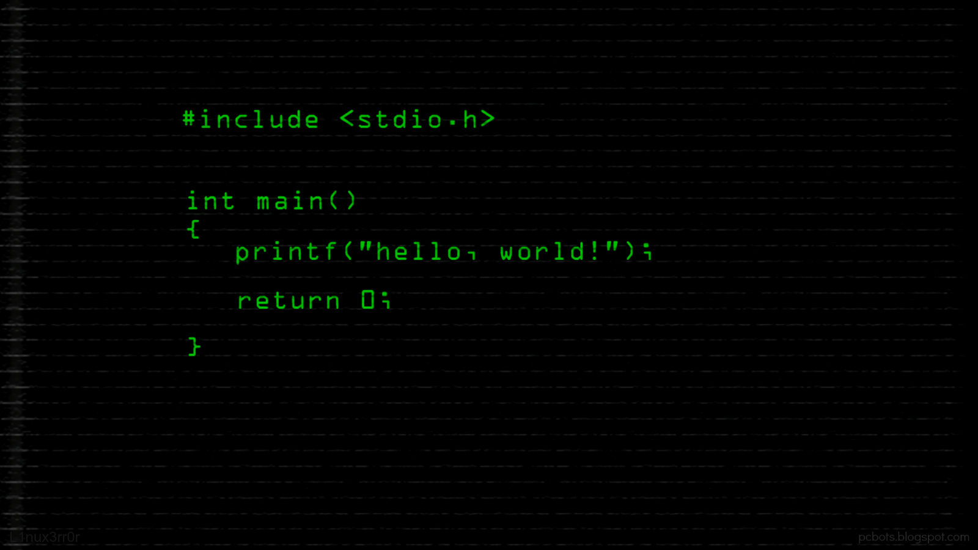
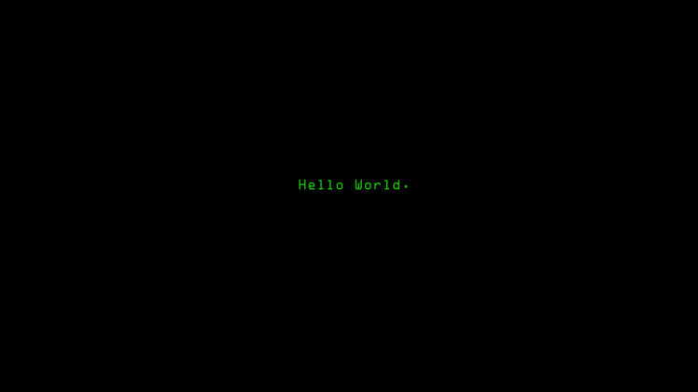

Slide 2

Design and analysis of algorithms
CSB 252
NATIONAL INSTITUTE OF TECHNOLOGY DELHI

Slide 3
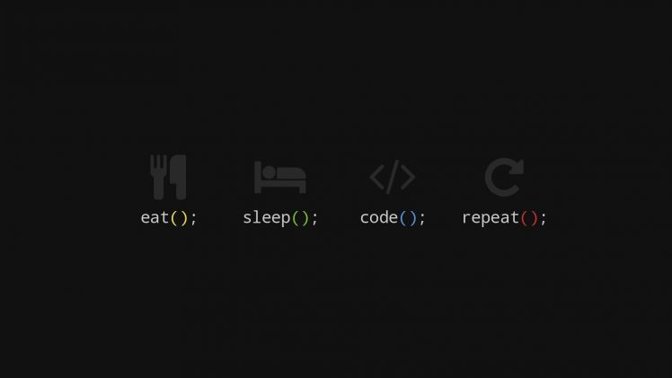

The knapsack problem is a problem in combinatorial optimization: Given a set of items, each with a weight and a value, determine the number of each item to include in a collection so that the total weight is less than or equal to a given limit and the total value is as large as possible. It derives its name from the problem faced by someone who is constrained by a fixed-size knapsack and must fill it with the most valuable items. The problem often arises in resource allocation where the decision makers have to choose from a set of non-divisible projects or tasks under a fixed budget or time constraint, respectively.

Slide 4
In computer science, divide and conquer is an algorithm design paradigm based on multi-branched recursion. A divide-and-conquer algorithm works by recursively breaking down a problem into two or more sub-problems of the same or related type, until these become simple enough to be solved directly. The solutions to the sub-problems are then combined to give a solution to the original problem.
Divide and Conquer

Slide 5

Divide and Conquer
Algorithm
A simple solution is to consider all subsets of items and calculate the total weight and value of all subsets. Consider the only subsets whose total weight is smaller than W. From all such subsets, pick the maximum value subset.
To consider all subsets of items, there can be two cases for every item: (1) the item is included in the optimal subset, (2) not included in the optimal set. Therefore, the maximum value that can be obtained from n items is max of following two values.1) Maximum value obtained by n-1 items and W weight (excluding nth item).2) Value of nth item plus maximum value obtained by n-1 items and W minus weight of the nth item (including nth item).If weight of nth item is greater than W, then the nth item cannot be included and case 1 is the only possibility.

Slide 6

Branch and bound is an algorithm design paradigm for discrete and combinatorial optimization problems, as well as mathematical optimization. A branch-and-bound algorithm consists of a systematic enumeration of candidate solutions by means of state space search: the set of candidate solutions is thought of as forming a rooted tree with the full set at the root. The algorithm explores branches of this tree, which represent subsets of the solution set. Before enumerating the candidate solutions of a branch, the branch is checked against upper and lower estimated bounds on the optimal solution and is discarded if it cannot produce a better solution than the best one found so far by the algorithm.
Branch and Bound

Slide 7
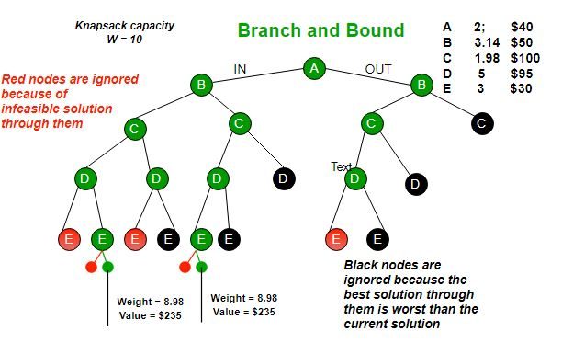
Branch and Bound
Algorithm
The Backtracking Solution can be optimized if we know a bound on best possible solution subtree rooted with every node. If the best in subtree is worse than current best, we can simply ignore this node and its subtrees. So we compute bound (best solution) for every node and compare the bound with current best solution before exploring the node.

Slide 8

GREEDY ALGORITHM
Greedy is an algorithmic paradigm that builds up a solution piece by piece, always choosing the next piece that offers the most obvious and immediate benefit. So the problems where choosing locally optimal also leads to global solution are best fit for Greedy.

Slide 9

Greedy Algorithm
In Fractional Knapsack, we can break items for maximizing the total value of knapsack. This problem in which we can break an item is also called the fractional knapsack problem.
An efficient solution is to use Greedy approach. The basic idea of the greedy approach is to calculate the ratio value/weight for each item and sort the item on basis of this ratio. Then take the item with the highest ratio and add them until we can’t add the next item as a whole and at the end add the next item as much as we can. Which will always be the optimal solution to this problem.

Slide 10
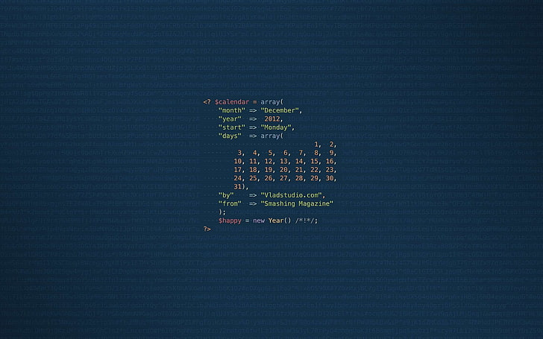
DYNAMIC PROGRAMMING
Dynamic Programming is a method for solving a complex problem by breaking it down into a collection of simpler subproblems, solving each of those subproblems just once, and storing their solutions using a memory-based data structure (array, map,etc).

Slide 11
Dynamic Programming Algorithm
In the following recursion tree, K() refers to knapSack(). The two
parameters indicated in the following recursion tree are n and W.
The recursion tree is for following sample inputs.
wt[] = {1, 1, 1}, W = 2, val[] = {10, 20, 30}
K(3, 2) ---------> K(n, W)
/ \
/ \
K(2,2) K(2,1)
/ \ / \
/ \ / \
K(1,2) K(1,1) K(1,1) K(1,0)
/ \ / \ / \
/ \ / \ / \
K(0,2) K(0,1) K(0,1) K(0,0) K(0,1) K(0,0)
Recursion tree for Knapsack capacity 2 units and 3 items of 1 unit weight.

Slide 12

Backtracking
Backtracking is an algorithmic-technique for solving problems recursively by trying to build a solution incrementally, one piece at a time, removing those solutions that fail to satisfy the constraints of the problem at any point of time

Slide 13
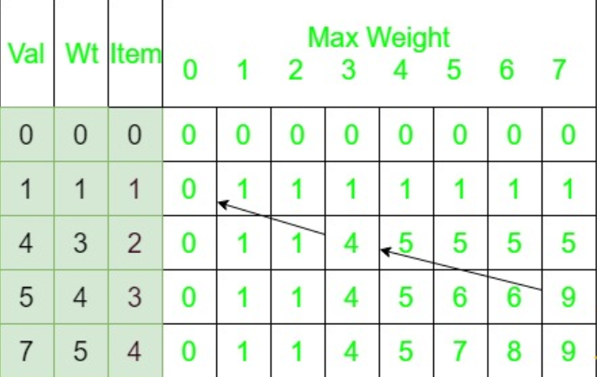
Backtracking approach
Let val[] = {1, 4, 5, 7}, wt[] = {1, 3, 4, 5}W = 7.The 2d knapsack table will look like :2d knapsack tableStart backtracking from K[n][W].Here K[n][W] is 9.Since, this value comes from the top (shown by grey arrow), the item in this row is not included. Go vertically upward in the table without including this in the knapsack. Now, this value K[n-1][W] which is 9 doesn’t come from the top which means the item in this row is included and go vertically up and then left by the weight of the included item ( shown by black arrow). Continuing this process include weights 3 and 4 with total value 9 in the knapsack.

Slide 14
Thanks
CSB 252
SAKSHAM MITTAL 181210045
RAHUL DEV KUREEL 181210039
NATIONAL INSTITUTE OF TECHNOLOGY DELHI

